Slide 1


Application of machine learning to predict cloud core numbers
R05229014 鄒適文
指導教授 吳健銘

Slide 2
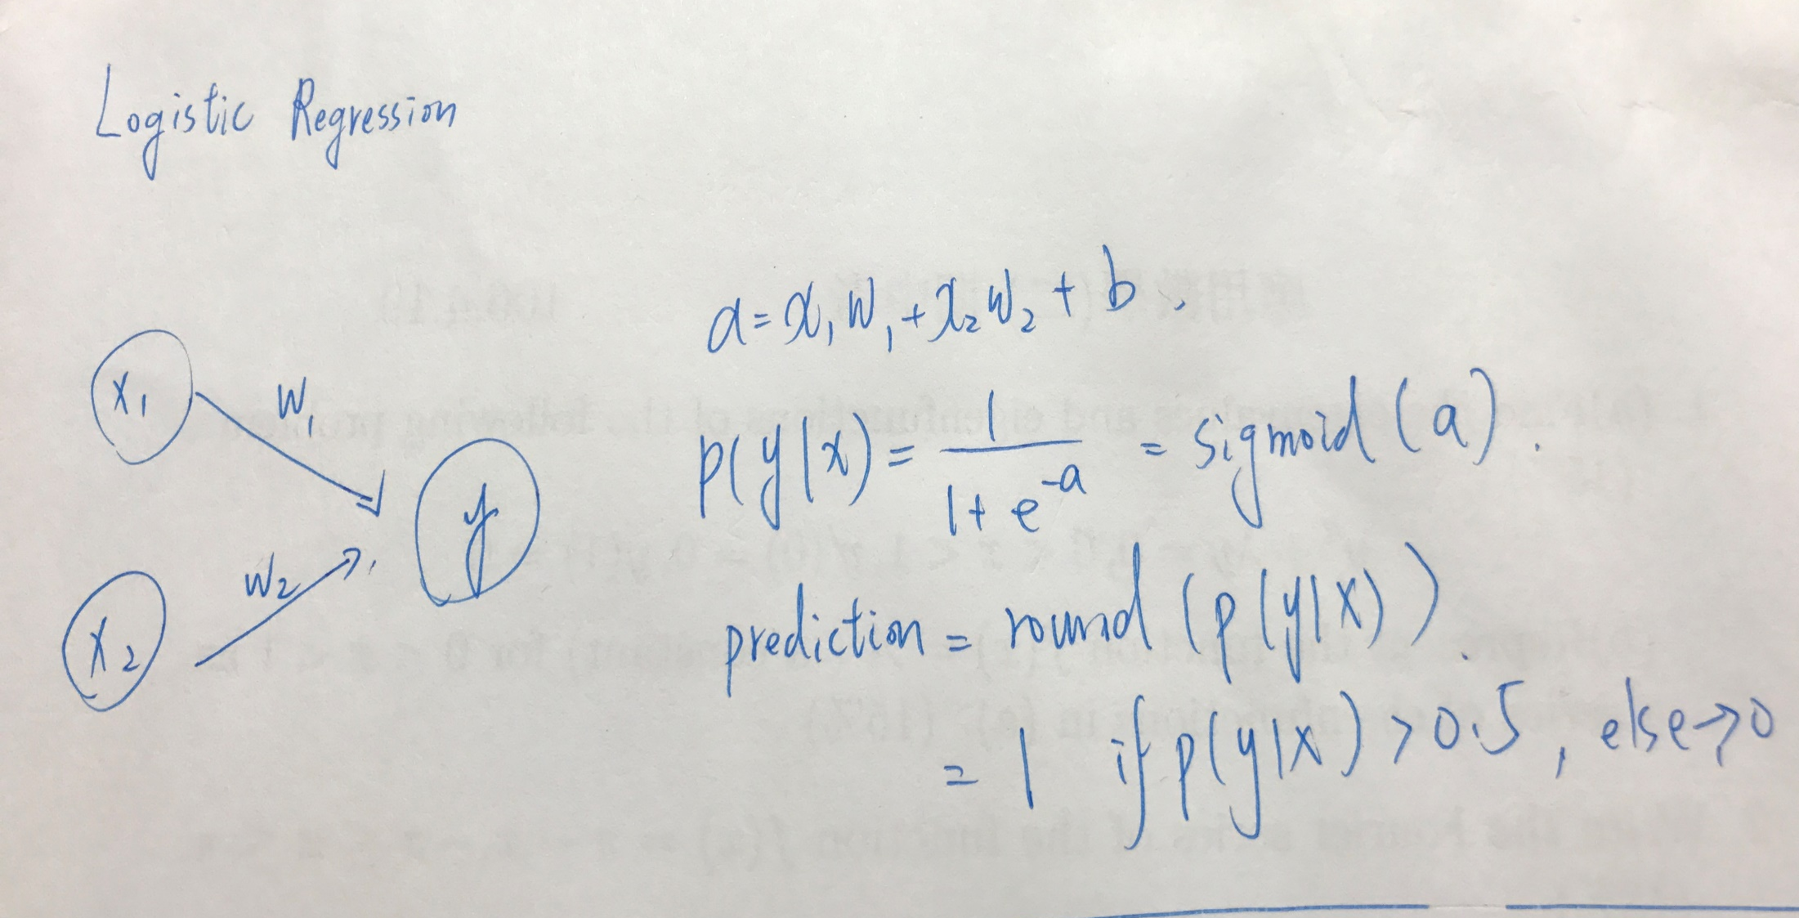
Math

Slide 3
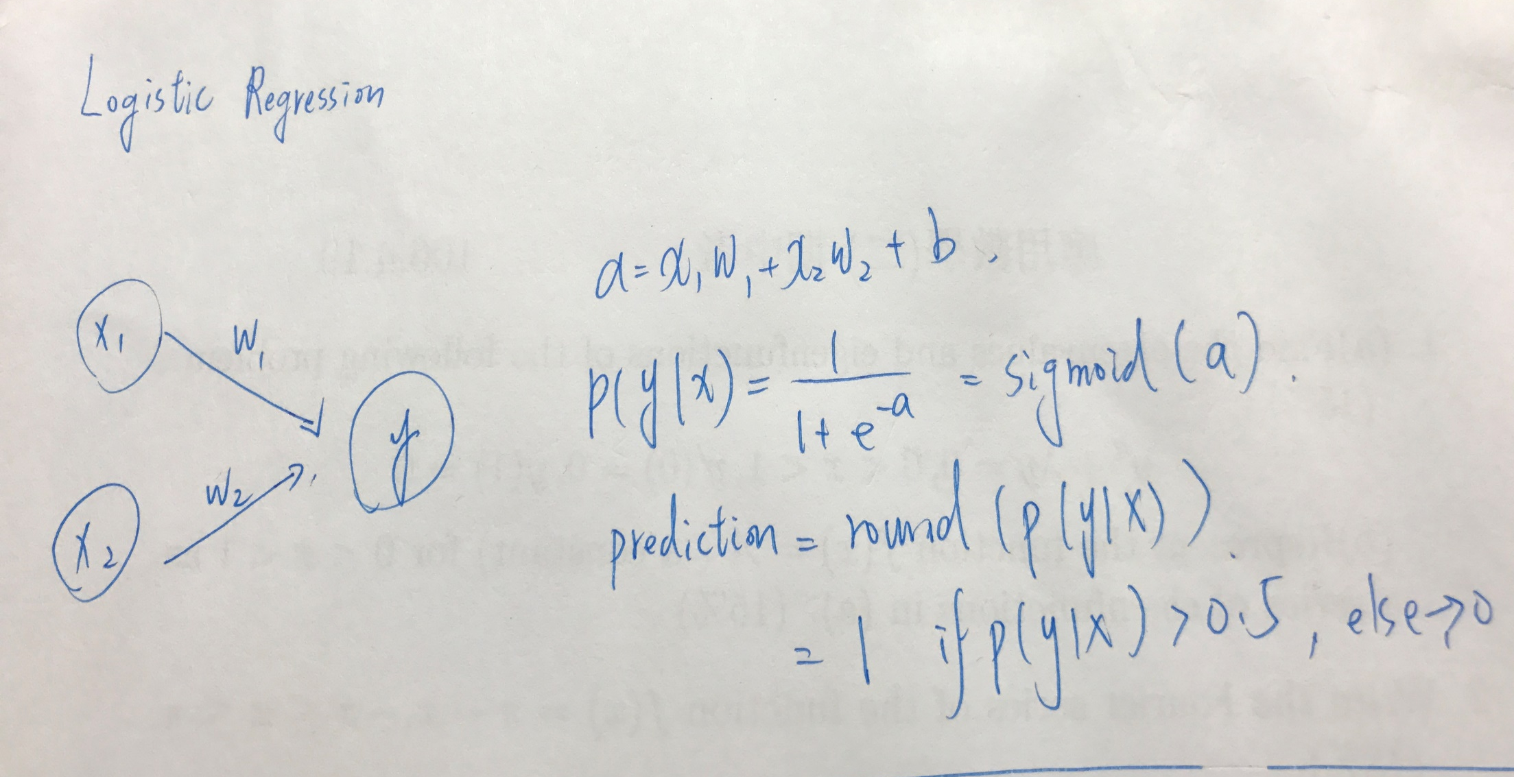
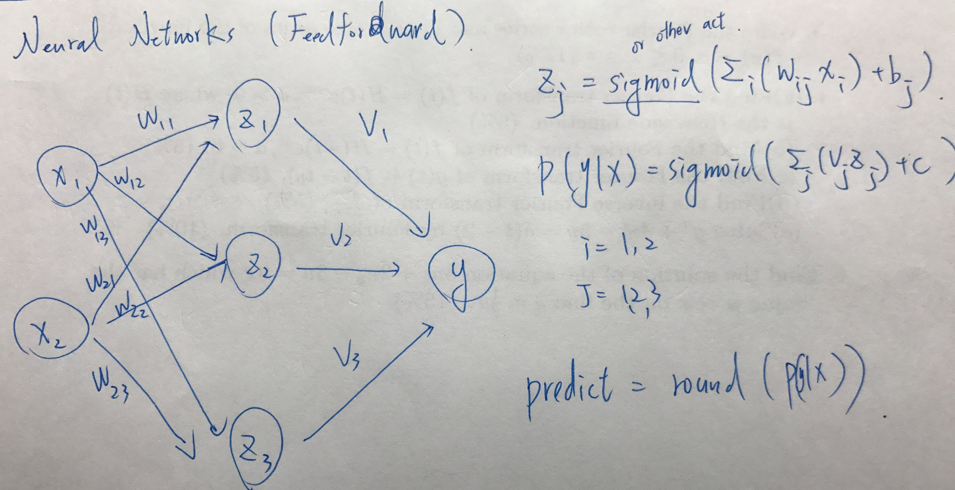
Math

Slide 4
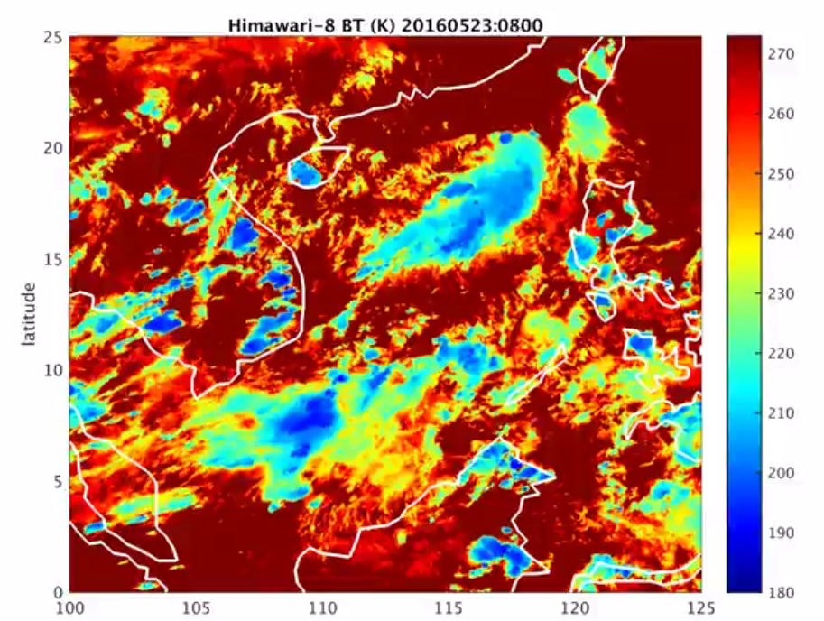
Ultimate Goal
Classifier
Core number =50
Core number =10
Core number =5

Slide 5
Architecture
建立神經網路、初始化
透過某些演算法縮小error
調整模型參數
模式建立成功or改進
運用VVM生成亮度溫度
透過h菜包大演算法定出雲胞
將資料分為訓練 ' 測試集
檢測正確率 in test set
驗證
Notes:
そして、レビューを入力する機械学習システムを紹介します。
前のスライドより、選ばれたレビュー文章を見出し語に変化し、最大エントロピー法を用いた機械学習を行います。
機械学習については、10分割のクロスバリデーションを行い、正解率を検証しています。
最後にはトレニンーグされたモデルを用いて、上位素性を取得しました。

Slide 6
Training Goal
Data we have
what we are interested in
Function (Artificial neural network)
Cloud information
Size, pcp, height…
How???????
Core number
Function (Artificial neural network)

Slide 7
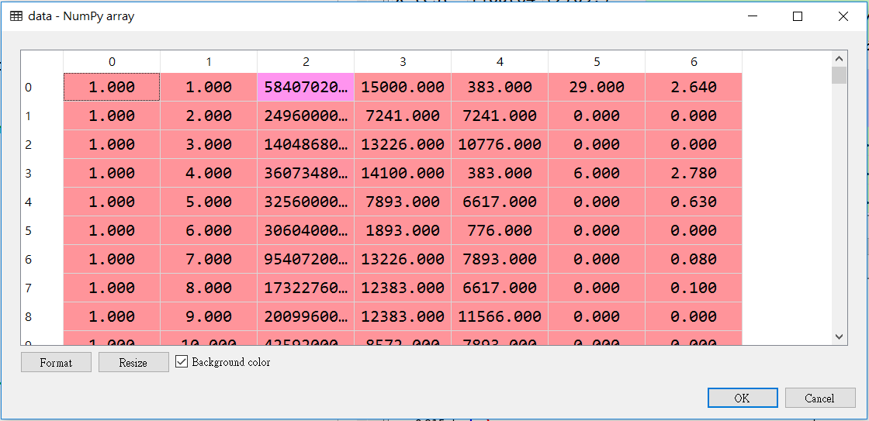
Data – VVM output (from Tsai)
Time | Cloud No. | Cloud size | Cloud top height | Cloud base height | Core numbers | precipitation

Slide 8
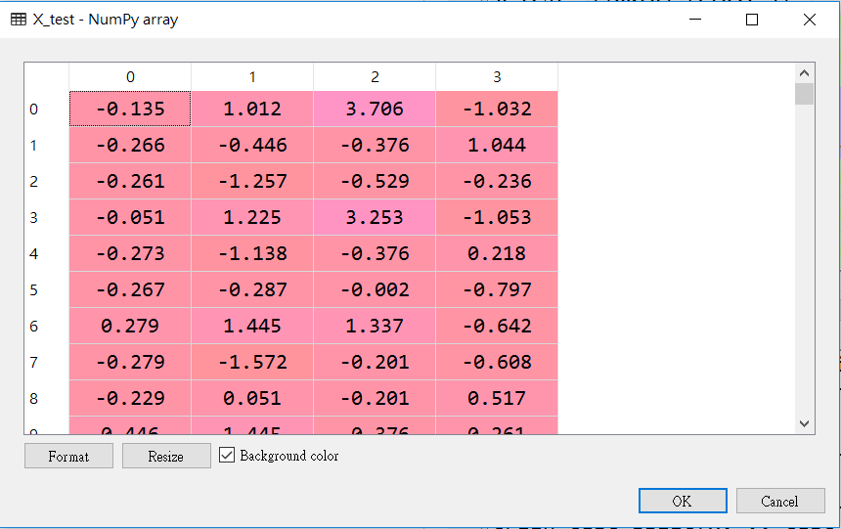
Data – VVM output (from Tsai)
Cloud size | Cloud top height | Cloud base height | precipitation

Slide 9
Data – VVM output (from Tsai)
Time | Cloud number | Cloud size | Cloud top height | Cloud base height | Core number | precipitation
18*18 | 13542 |  |  |  | >1

Slide 10
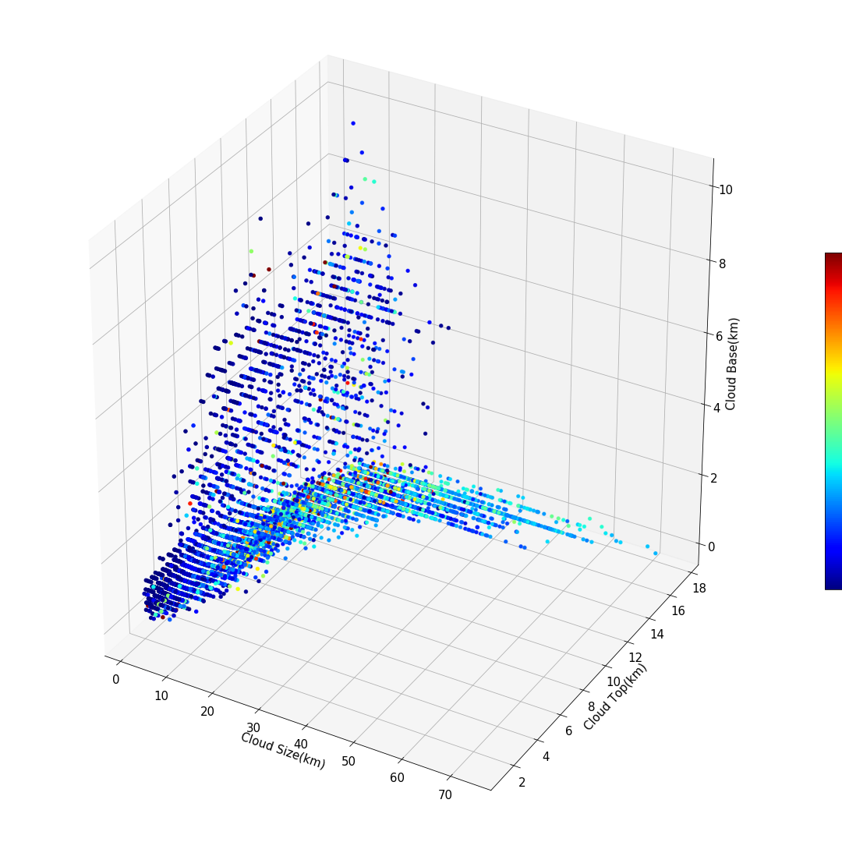
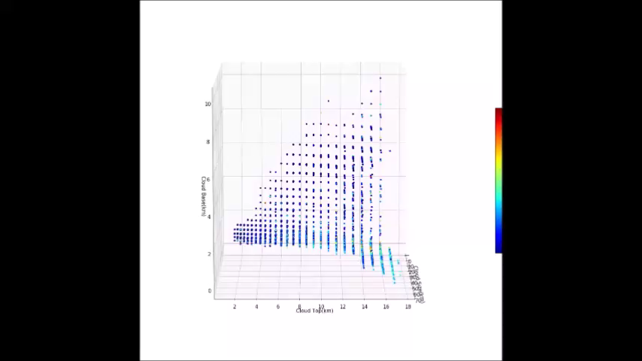
Data – VVM output (from Tsai)
10
mm/hr
0

Slide 11
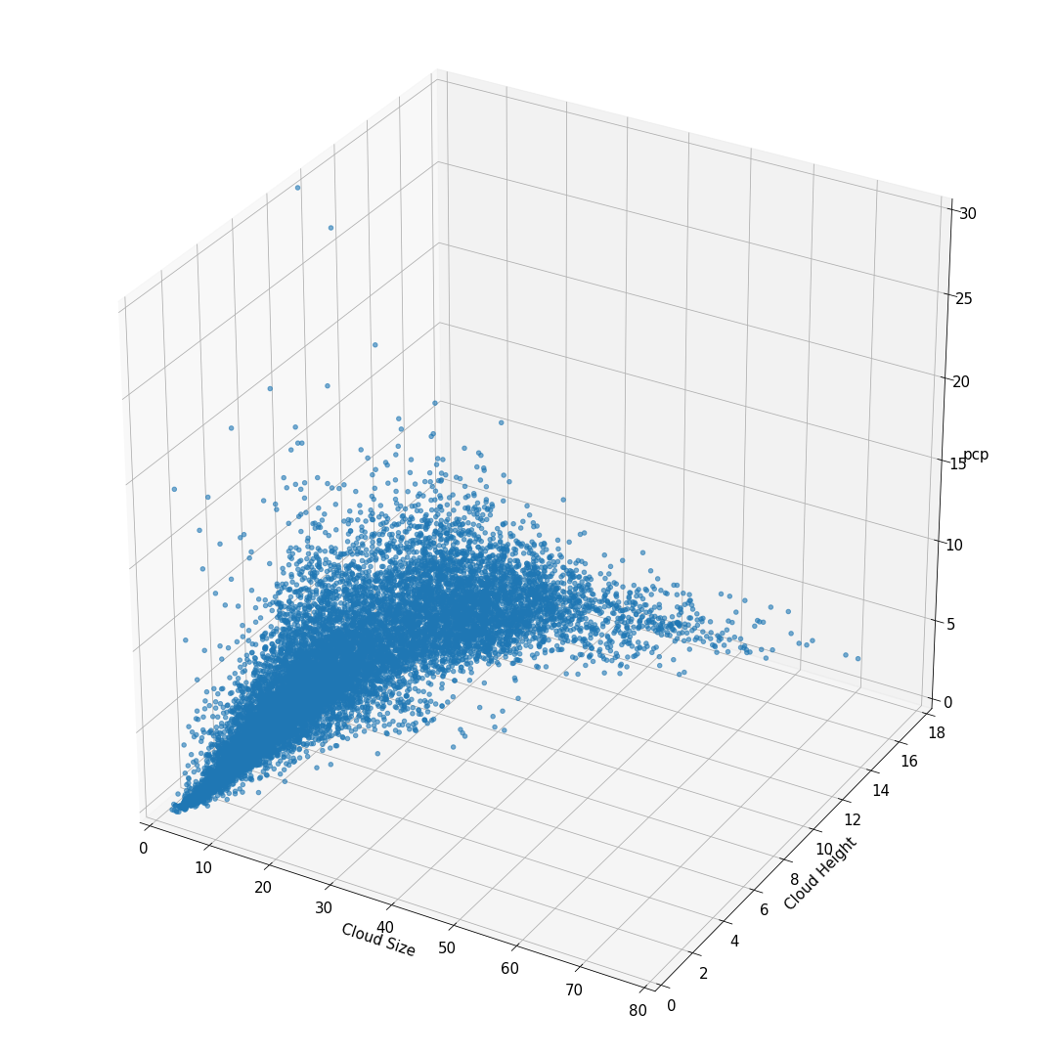
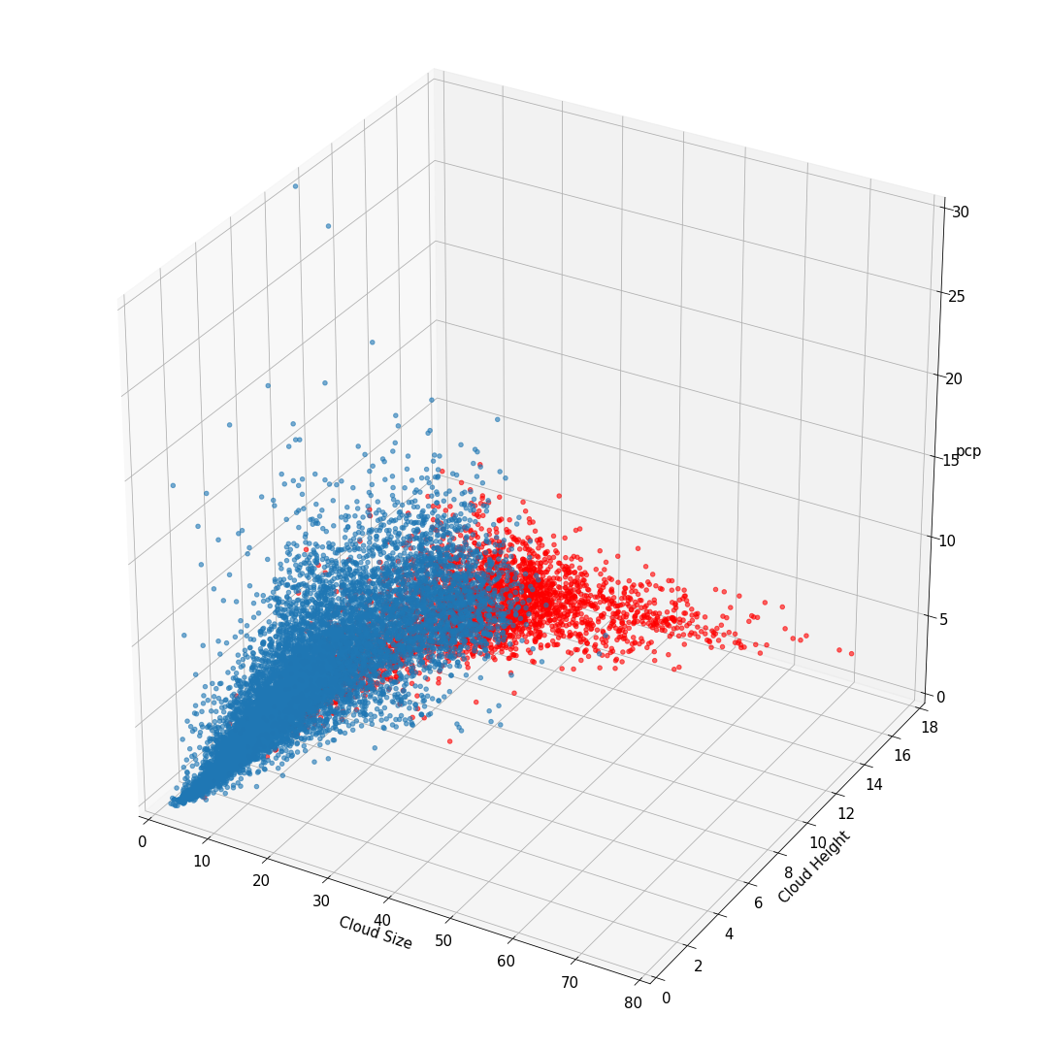
Data – VVM output (from Tsai)

Slide 12
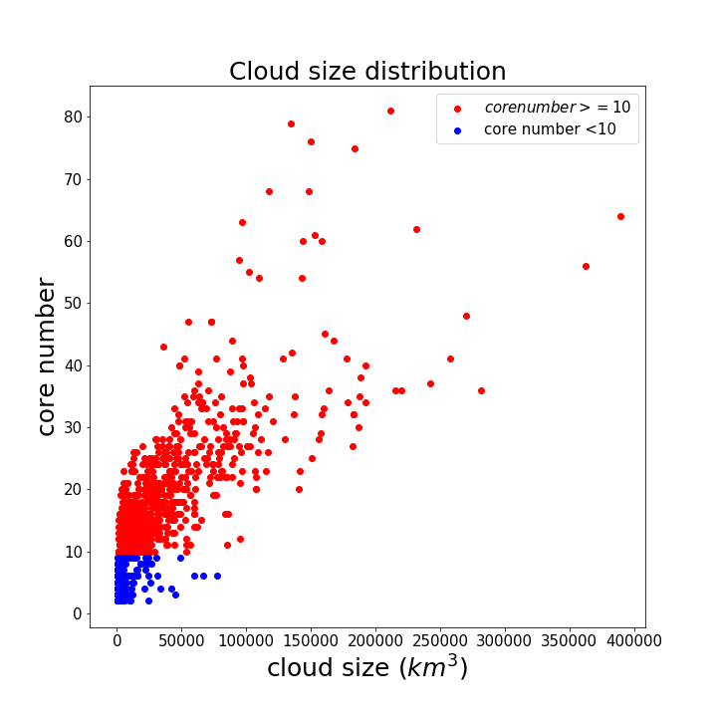
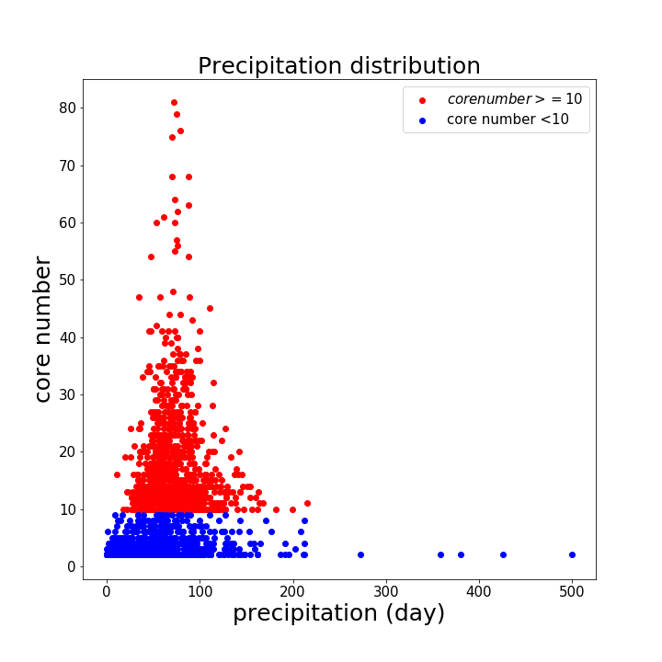
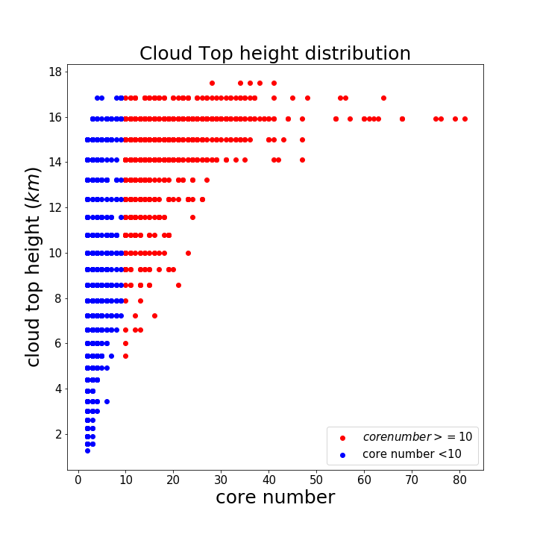
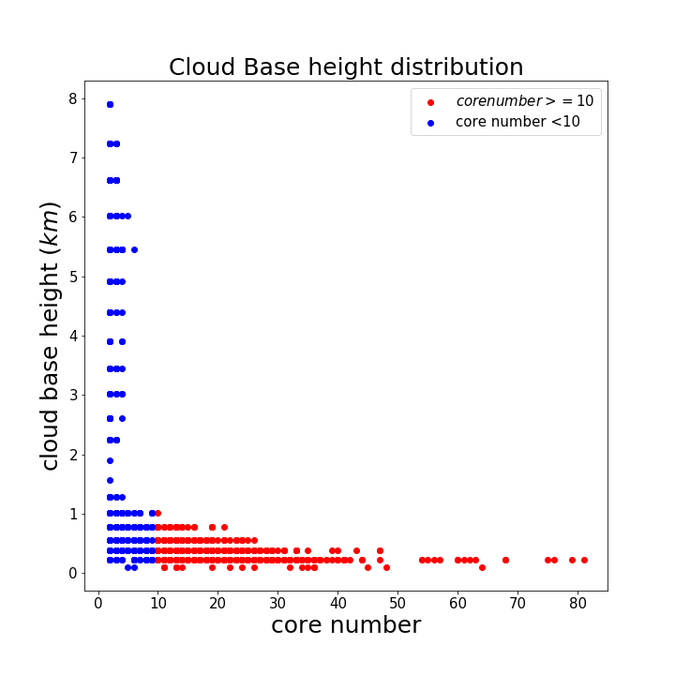
Data – VVM output (from Tsai)
Cloud size | precipitation | Cloud top height | Cloud base height

Slide 13
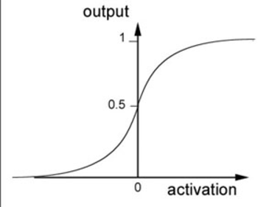
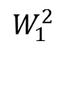
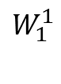
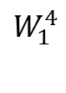
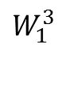
The model (Fully connected ANN)
Input layer | Hidden layer | Hidden layer | Hidden layer | Output layer
Sigmoid
Sigmoid
Sigmoid
$$W_{1}^{2}$$
$$W_{1}^{3}$$
$$W_{1}^{1}$$
$$W_{1}^{4}$$
Sigmoid
Sigmoid
Sigmoid
input
Sigmoid
output
Sigmoid
Sigmoid
Sigmoid
Core >=10 or not
Sigmoid
Sigmoid
Sigmoid

Slide 14
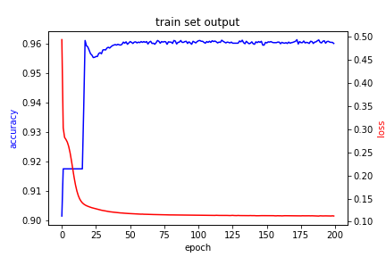
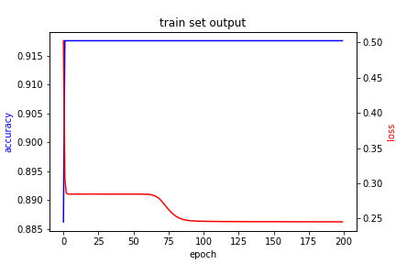
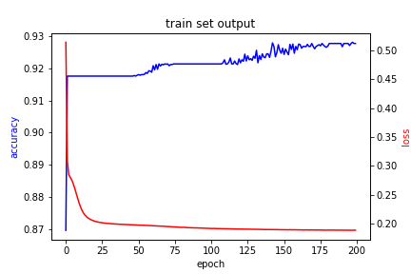
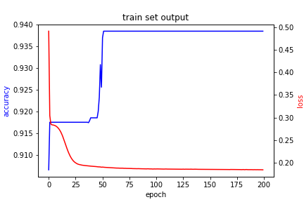
Model evaluate (input one variable) – training set
Cloud size | precipitation | Cloud top height | Cloud base height

Slide 15
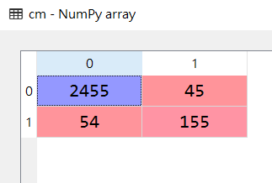
Model evaluate (input one variable) –Test set
Cloud size | precipitation | Cloud top height | Cloud base height
預測是core<10的雲
cm = confusion_matrix
預測是core>=10的雲
Accuracy and loss at test set
Accuracy | loss
0.96345514 | 0.10445079
v
v
Big cloud(core>=10)
本來是core<10的雲
本來是core>=10的雲
Accuracy
0.74162

Slide 16
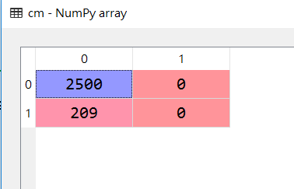
Model evaluate (input one variable) –Test set
Cloud size | precipitation | Cloud top height | Cloud base height
cm = confusion_matrix
Accuracy and loss at test set
Accuracy | loss
0.92284976 | 0.36415451
Big cloud(core>=10)
Accuracy
0

Slide 17
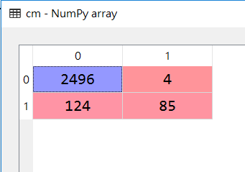
Model evaluate (input one variable) –Test set
Cloud size | precipitation | Cloud top height | Cloud base height
cm = confusion_matrix
Accuracy and loss at test set
Accuracy | loss
0.95275009 | 0.15372456
Big cloud(core>=10)
Accuracy
0.40669

Slide 18
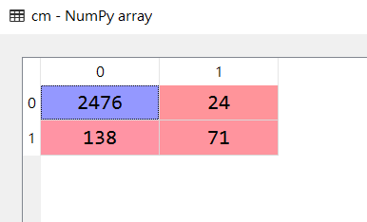
Model evaluate (input one variable) –Test set
Cloud size | precipitation | Cloud top height | Cloud base height
cm = confusion_matrix
Accuracy and loss at test set
Accuracy | loss
0.94019933 | 0.17771212
Big cloud(core>=10)
Accuracy
0.3397

Slide 19
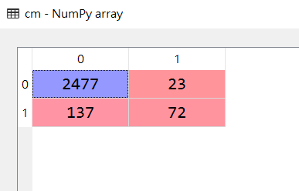
Model evaluate (input three variable) –Test set
Cloud size | precipitation | Cloud top height | Cloud base height
cm = confusion_matrix
Accuracy and loss at test set
Accuracy | loss
0.9409376 | 0.15735944
Big cloud(core>=10)
Accuracy
0.344449

Slide 20
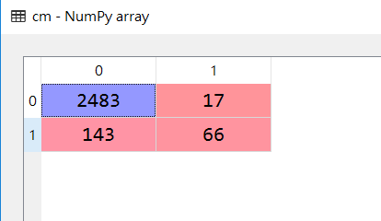
Model evaluate (input three variable) –Test set
Cloud size | precipitation | Cloud top height | Cloud base height
cm = confusion_matrix
Accuracy and loss at test set
Accuracy | loss
0.94093761 | 0.14939170
Big cloud(core>=10)
Accuracy
0.31578

Slide 21
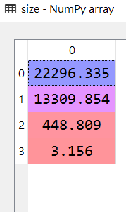
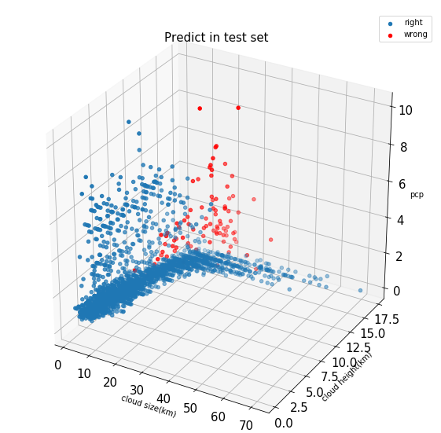
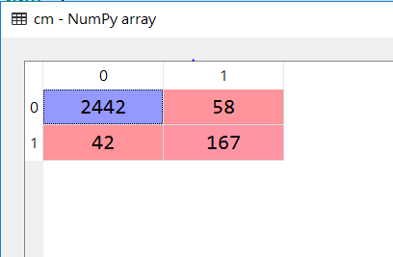
Model evaluate (input four variable) –Test set
Cloud size | precipitation | Cloud top height | Cloud base height
cm = confusion_matrix
Accuracy and loss at test set
Accuracy | loss
0.96308601 | 0.083921578
Big cloud(core>=10)
Accuracy
0.79904

Slide 22
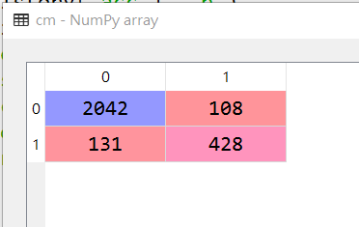
Model evaluate (input four variable) –Test set
Cloud size | precipitation | Cloud top height | Cloud base height
cm = confusion_matrix
Accuracy and loss at test set
Accuracy | loss
0.9117755 | 0.2108229
Big cloud(core>=5)
Accuracy
0.76565

Slide 23
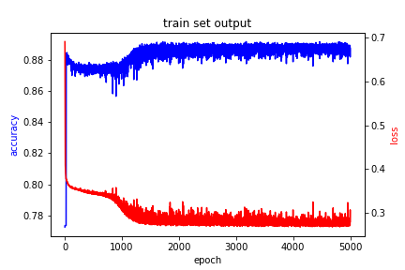
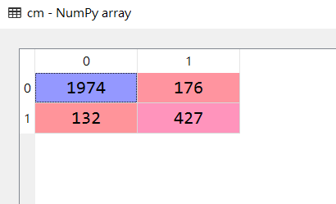
Model evaluate (input four variable) –Test set
Cloud size | precipitation | Cloud top height | Cloud base height
cm = confusion_matrix
Accuracy and loss at test set
Accuracy | loss
0.88630491 | 0.29028649
Big cloud(core>=5)
Accuracy
0.76386
Notes:
4(4)層ANN relu+sigmoid, adam, binary_crossentropy
NO feature scaling
Batch =500 , epoch =5000

Slide 24
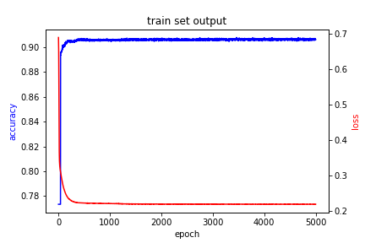
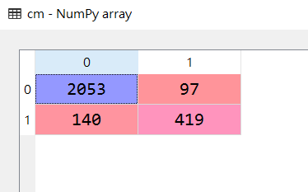
Model evaluate (input four variable) –Test set
Cloud size | precipitation | Cloud top height | Cloud base height
cm = confusion_matrix
Accuracy and loss at test set
Accuracy | loss
0.91251384 | 0.20820352
Big cloud(core>=5)
Accuracy
0.74955
Notes:
4(4)層ANN relu+sigmoid, adam, binary_crossentropy
normallized
Batch =500 , epoch =5000

Slide 25
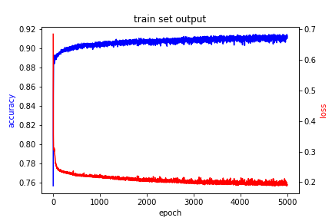
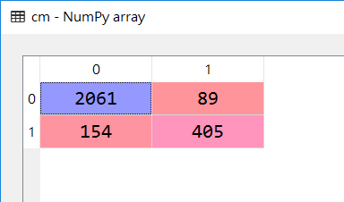
Model evaluate (input four variable) –Test set
Cloud size | precipitation | Cloud top height | Cloud base height
cm = confusion_matrix
Accuracy and loss at test set
Accuracy | loss
0.91325212 | 0.21765163
Big cloud(core>=5)
Accuracy
0.724508
Notes:
6(20)層ANN relu+sigmoid, adam, binary_crossentropy
No normallized
Batch =500 , epoch =5000

Slide 26
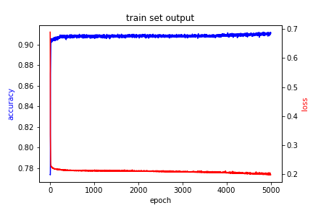
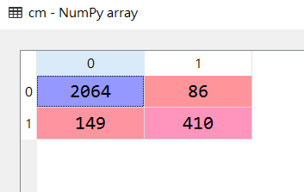
Model evaluate (input four variable) –Test set
Cloud size | precipitation | Cloud top height | Cloud base height
cm = confusion_matrix
Accuracy and loss at test set
Accuracy | loss
0.91325212 | 0.21765163
Big cloud(core>=5)
Accuracy
0.73345
Notes:
6(20)層ANN relu+sigmoid, adam, binary_crossentropy
normallized
Batch =500 , epoch =5000

Slide 27
Summary
以下結論都只是對這份資料下的結論
1. 平均降水對core數的判斷沒有幫助
2. 雲底、雲頂高度有助於分類器對core數低(的雲)之正確率
3. 但只用雲頂高度作為訓練資料分類器的表現比較好
4. 雲體積顯然是判斷core數最重要的參數
5. 對資料的feature scaling可以讓分類器表現更好(但在有gpu的幫忙下，我們可以直接把神經網路加深，解決這問題)
Notes:
6(20)層ANN relu+sigmoid, adam, binary_crossentropy
normallized
Batch =500 , epoch =5000

Slide 28
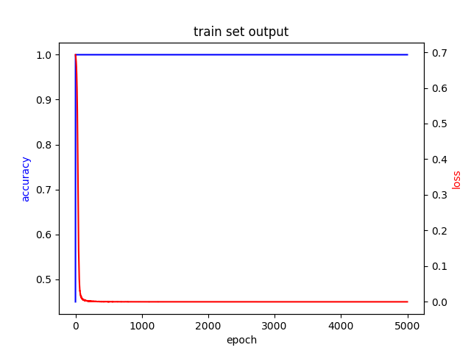
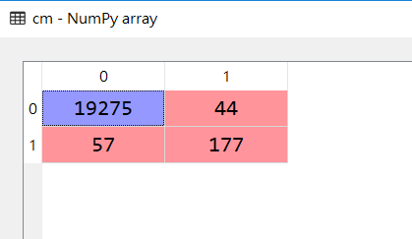
Model evaluate (input four variable) –Test set
Cloud size | precipitation | Cloud top height | Cloud base height
cm = confusion_matrix
Accuracy and loss at test set
Accuracy | loss
0.99483455 | 0.01218817
Big cloud(core>=5)
Accuracy
0.756410
Notes:
6(20)層ANN relu+sigmoid, adam, binary_crossentropy
normallized
Batch =500 , epoch =5000

